Slide 1
Machine Learning IDS
Todd Burke
Mark Dechant
Avinash Guthakari
Isaac Syler
Alex Towell
CS 590 Computer Network Defense

Slide 2
Overview
Introduction
Intrusion Detection Systems (IDS)
Machine Learning
Cost of IDS Alerts
Data Classifiers
Conclusion

Slide 3
Introduction
IDS’s of Today are inherently prone to false positives and false negatives because types of attacks are all weighted equally and responded to with same Computer Emergency Response tactics, techniques and policies while not associating the cost to business.

Slide 4
Intrusion Detection Systems
Primarily two types
Signature Based
Anomaly Based
Error Prone
False Positives
False Negatives

Slide 5
Machine Learning
Algorithm to Classify Data
Supervised and Unsurprised
Training Data
Test Data Set
Operation Data Set
On-Line (Real-time)/Off-Line (Data Mining)

Slide 6
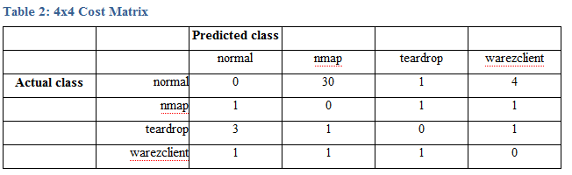
Cost of IDS Alerts
Cost of Responding to Alerts
Weighting Types of Data

Slide 7
Data Classifiers
Decision Tree
BayesNet Classifier

Slide 8
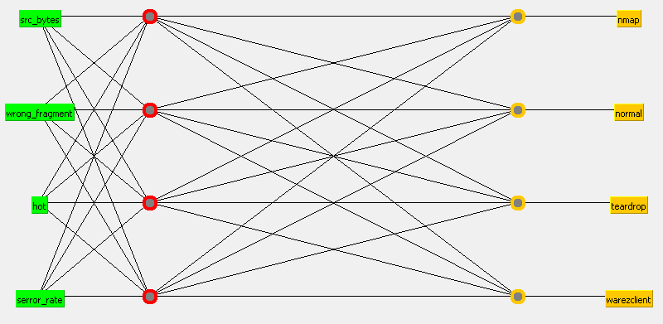

Slide 9
Conclusion
Current IDS’s are Inherently Error Prone
Adding Expected Alert Cost Can Improve Performance
Machine Learning to Classify Network Traffic Can Aid in Response Decision Making Based on Business Needs.

Slide 10
Questions
?

